Slide 1
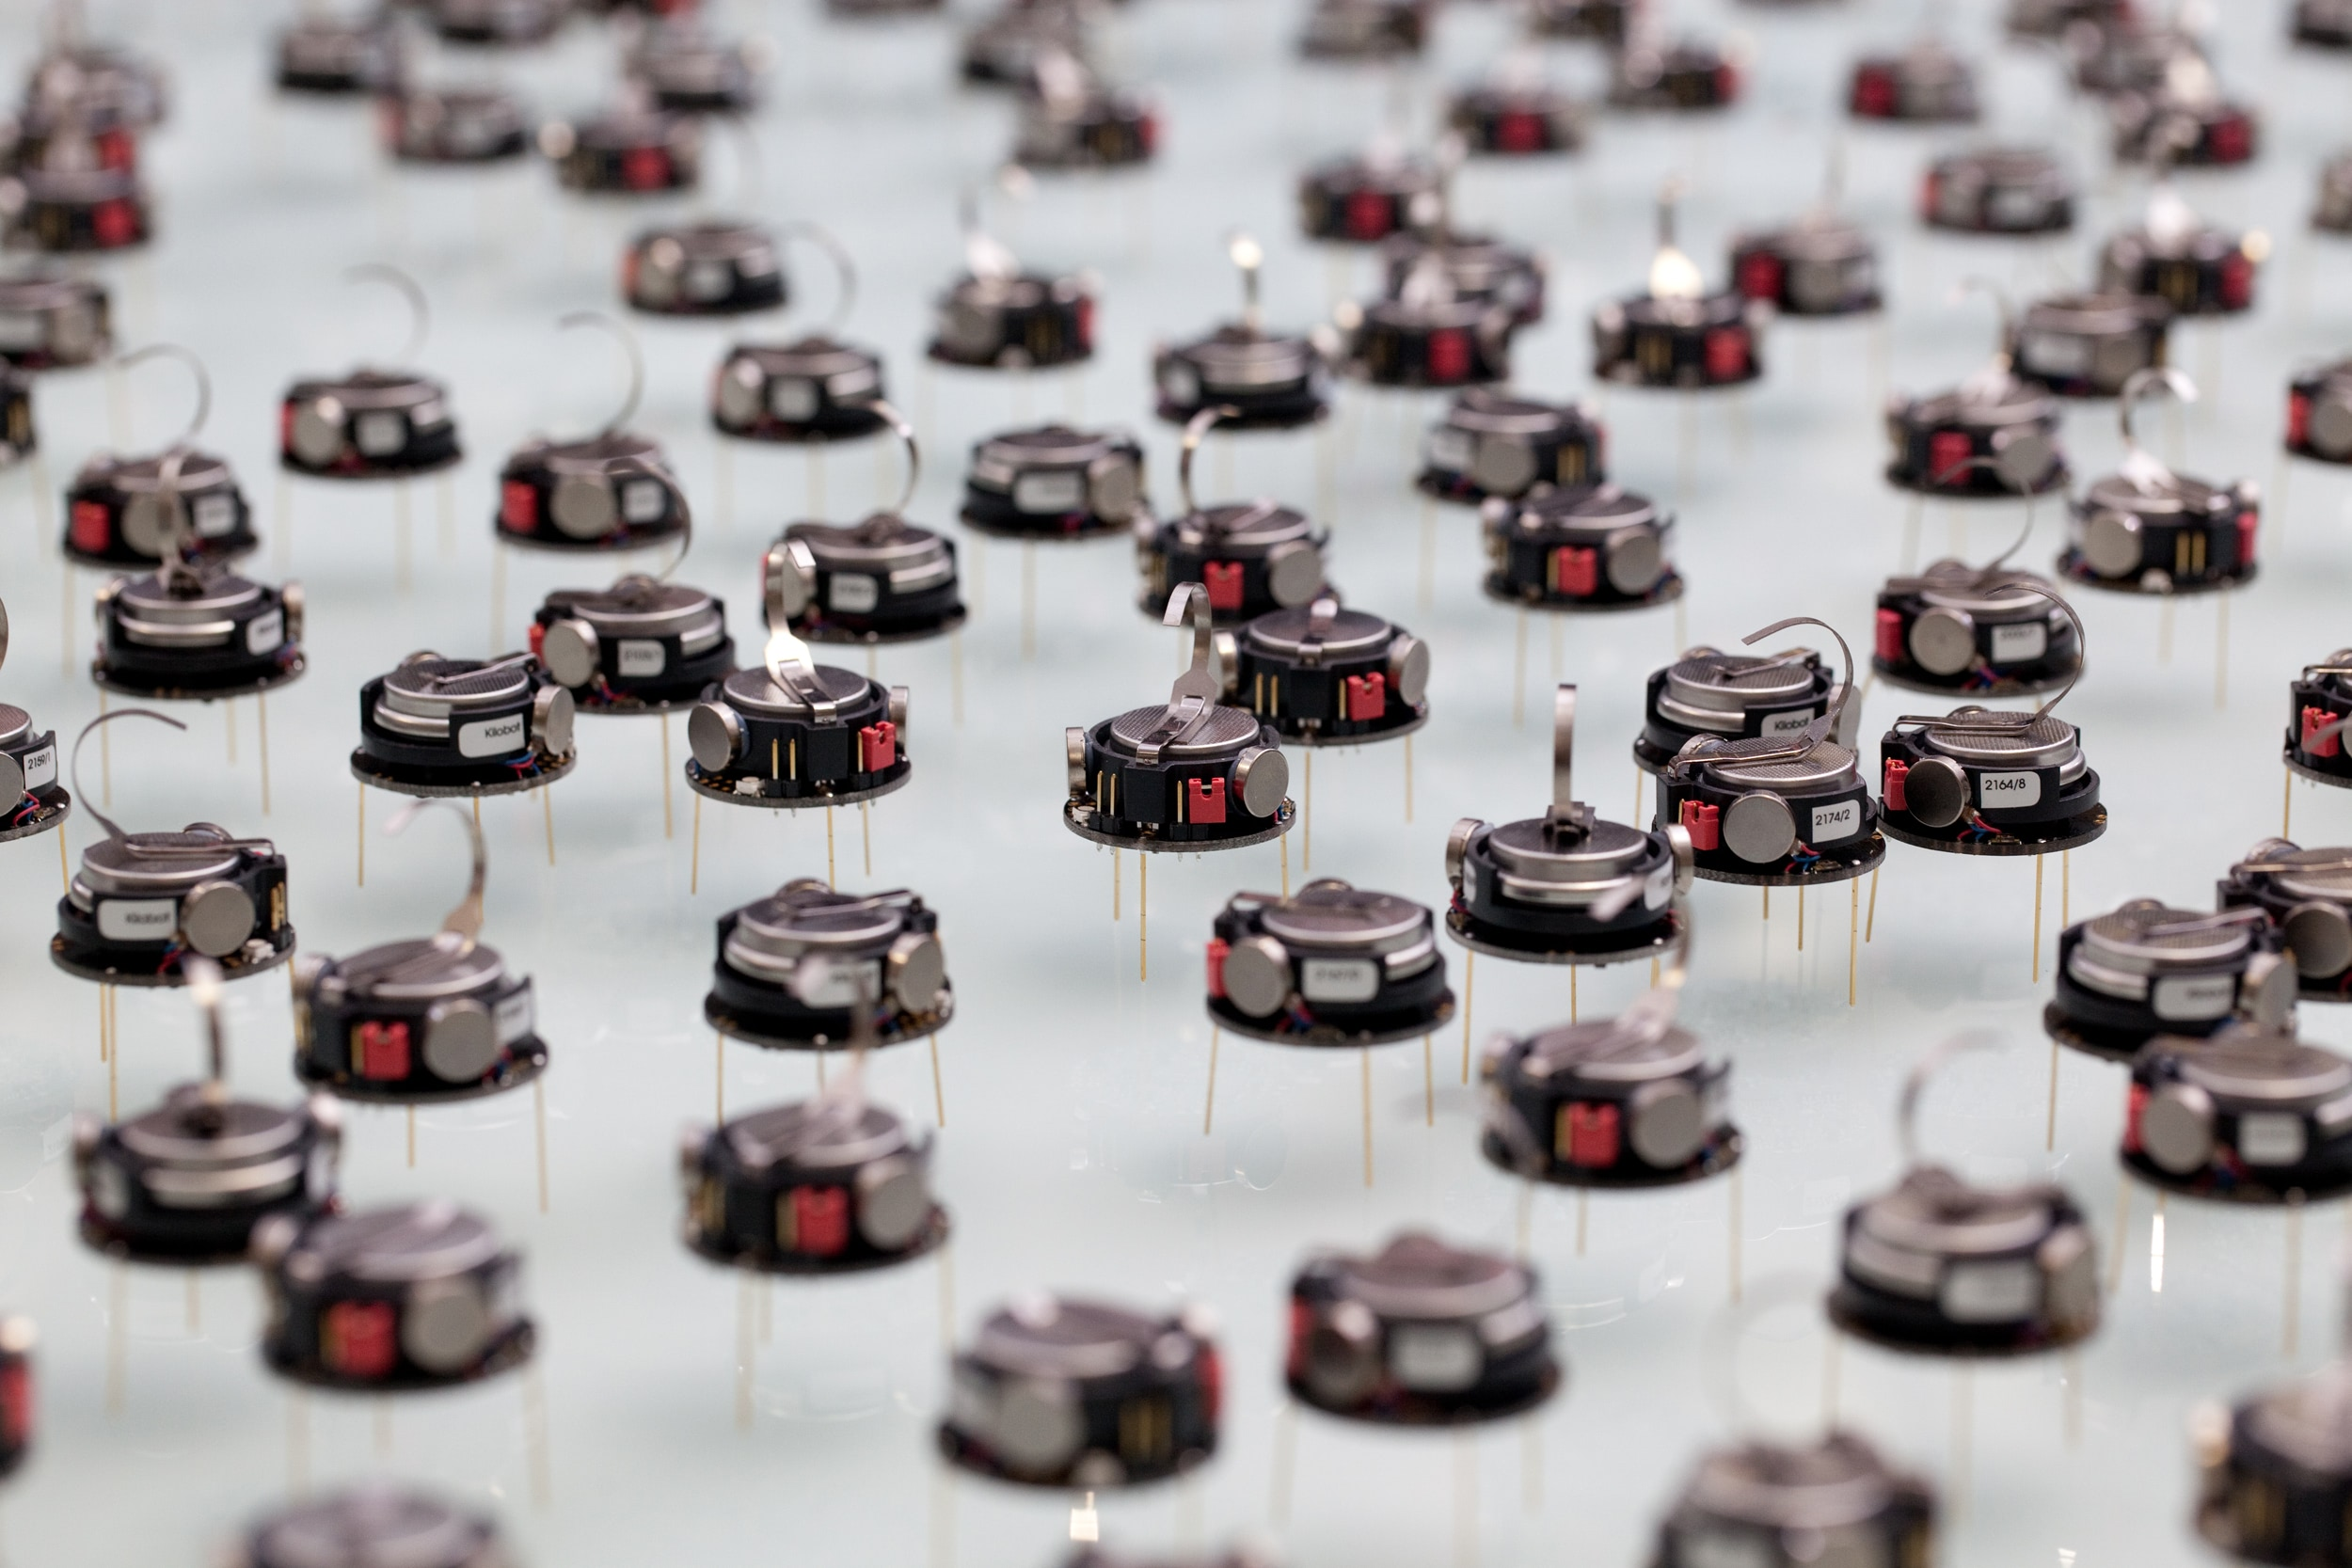
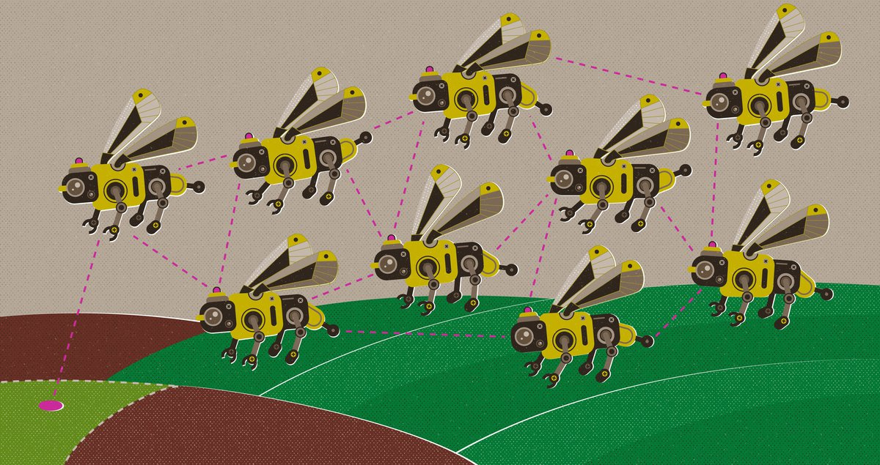
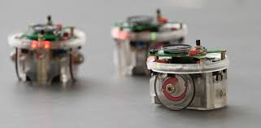
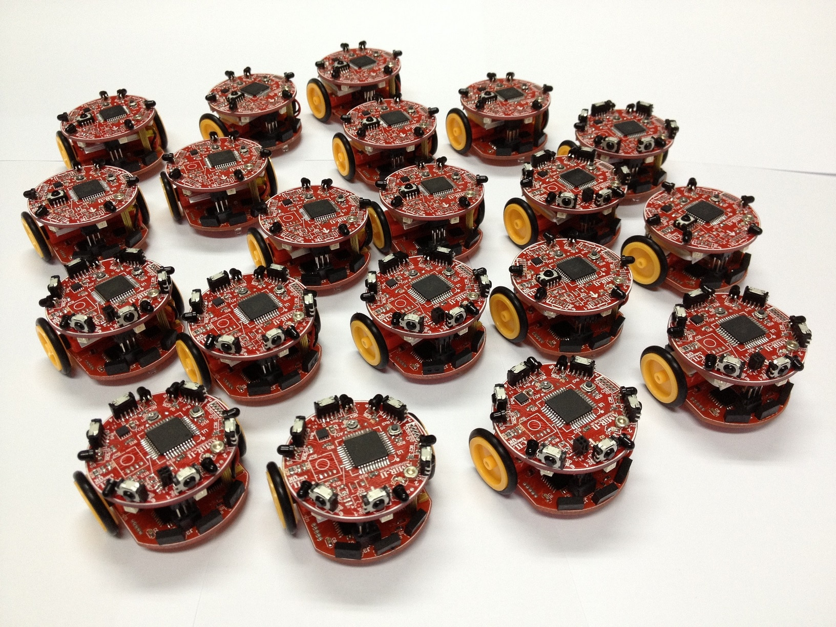
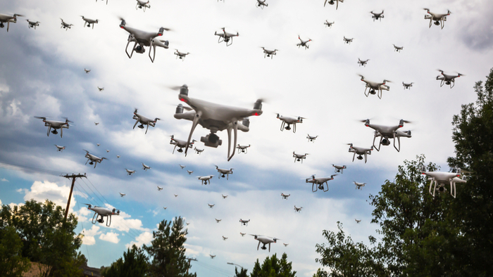
Swarm Robotics

Slide 2
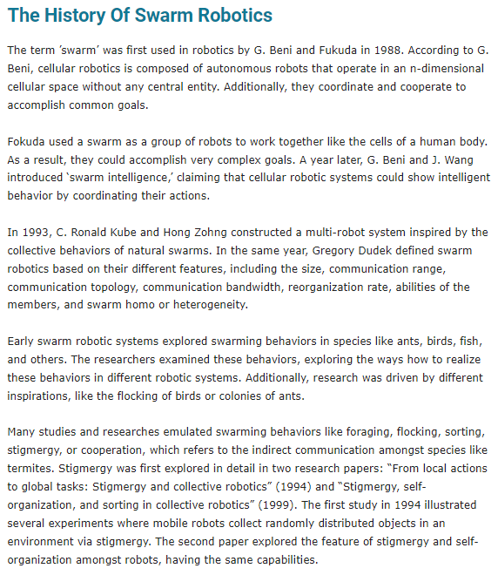
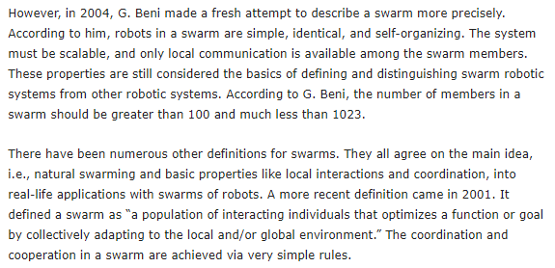
Swarm robotics has its origins in swarm intelligence and, in fact, could be defined as "embodied swarm intelligence". Initially, the main focus of swarm robotics research was to study and validate biological research (Beni, 2005). Early collaboration between roboticists and biologists helped bootstrap swarm robotics research, which has since become a research field in its own right. In recent years, the focus of swarm robotics has been shifting: from a bio-inspired field of robotics, swarm robotics is increasingly becoming an engineering field whose focus is on the development of tools and methods to solve real problems (Brambilla et al., 2013).

Slide 3
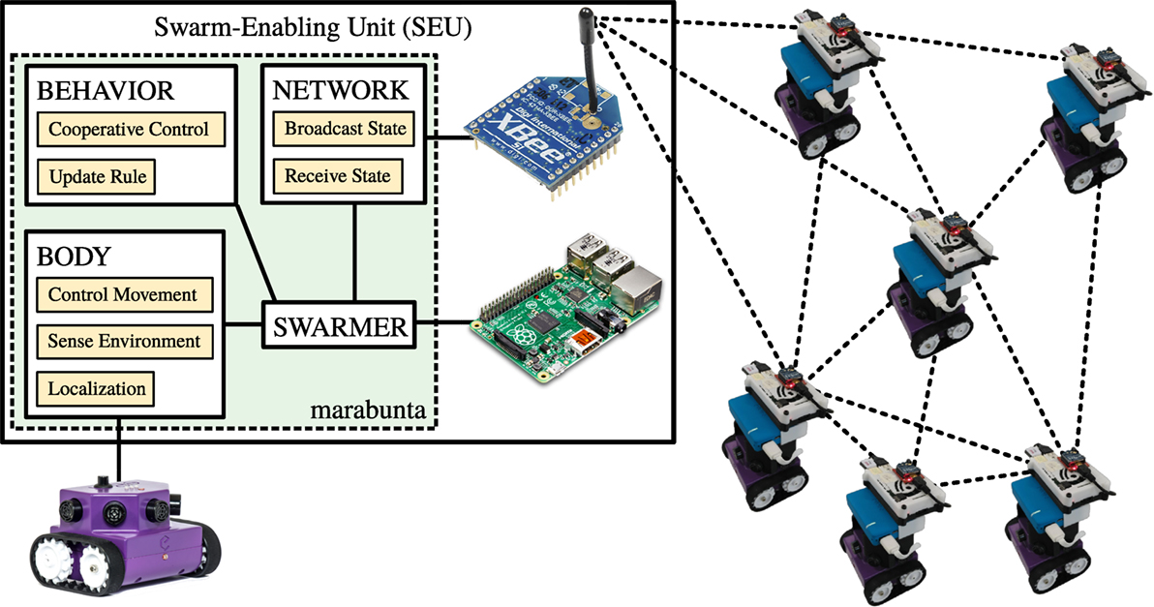
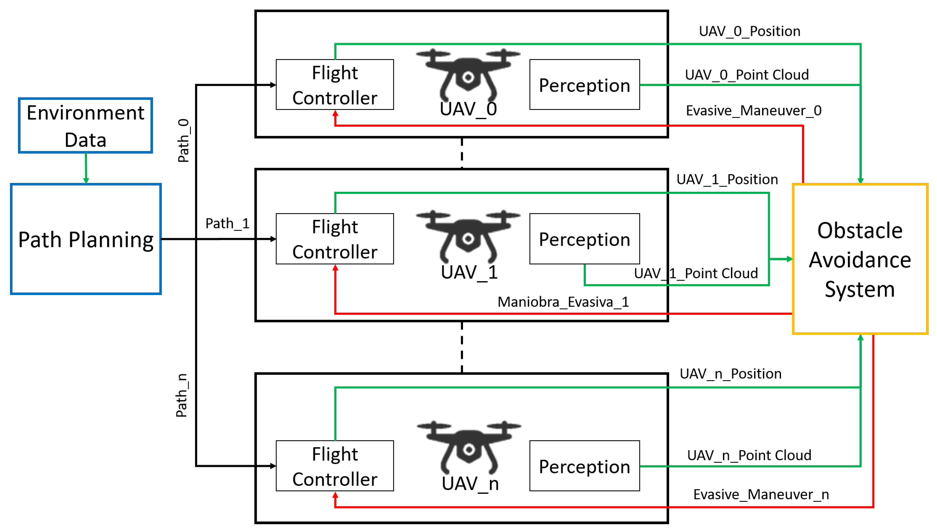
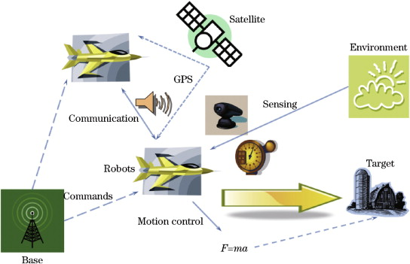
Basic System Architecture

Slide 4
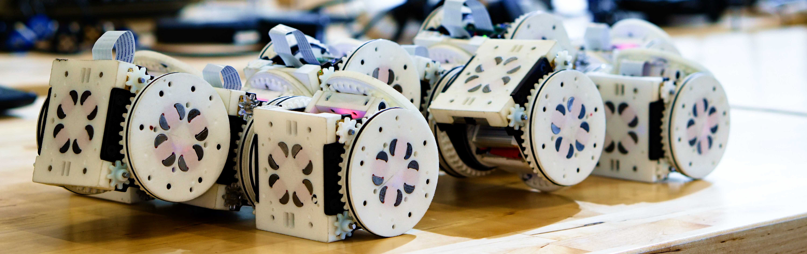
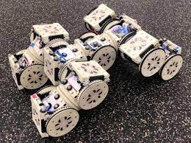
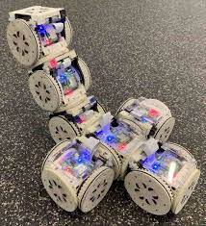
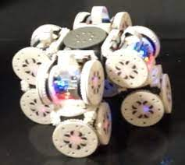
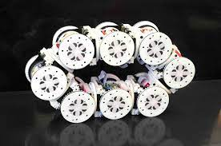
SMORES (Self-assembling MOdular Robot for Extreme Shapeshifting) – EP (Electro-Permanent) magnets

Slide 5
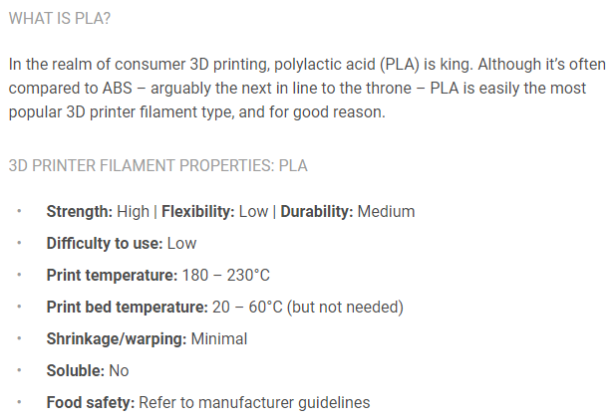
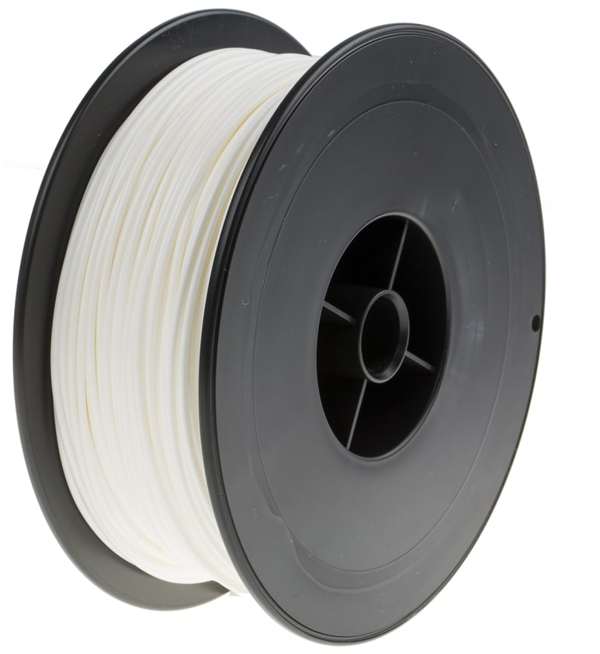
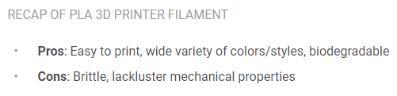
Robot design vs task
PLA

Slide 6
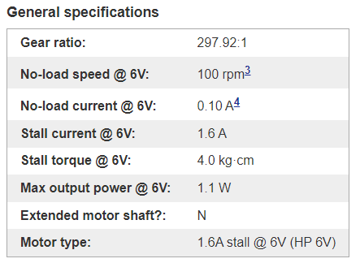
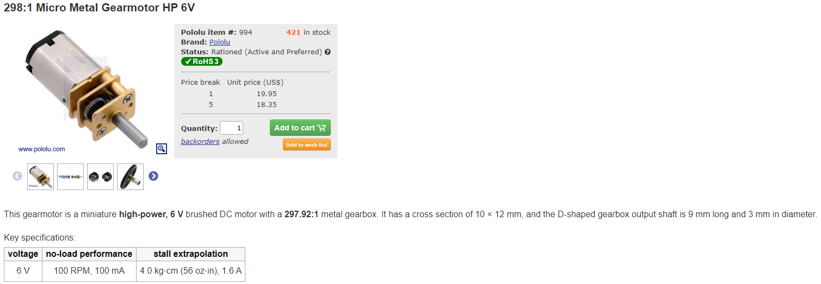
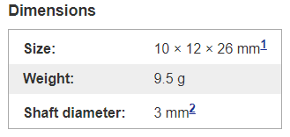
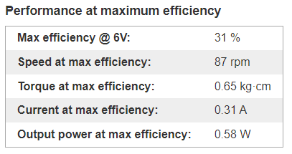
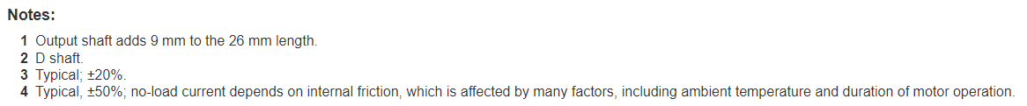
Actuator/Locomotion
DC Motor

Slide 7
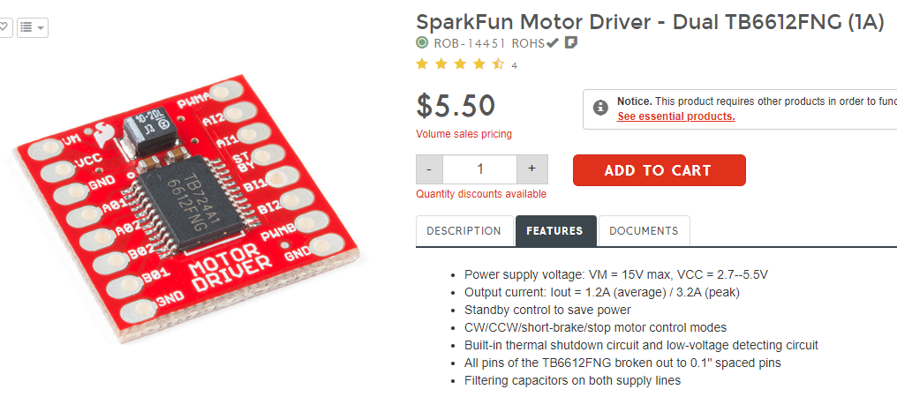
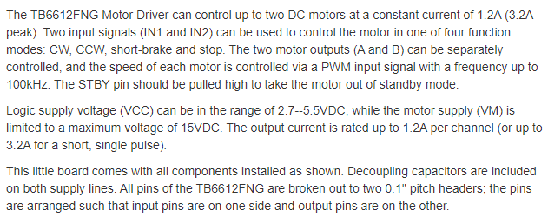
Motor Driver

Slide 8
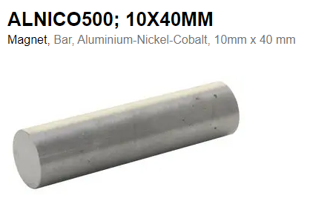
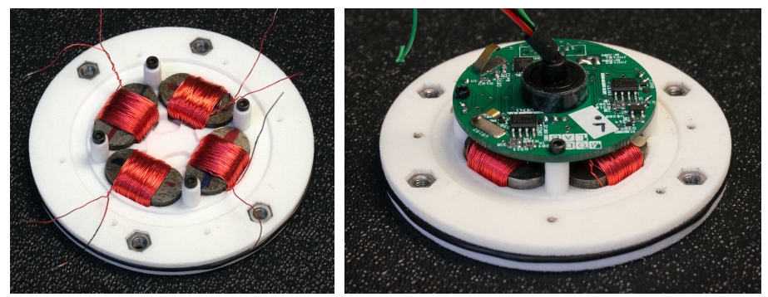

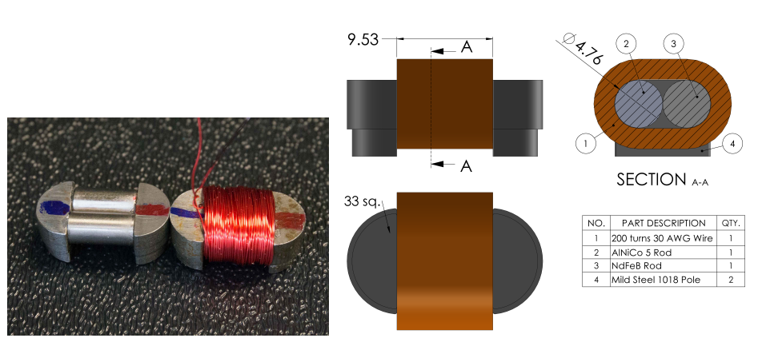
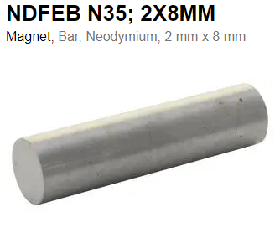

Electro-Permanent Magnets

Slide 9
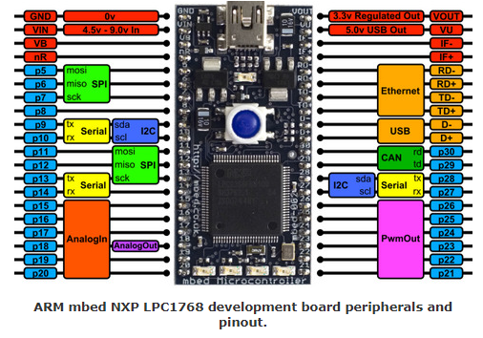
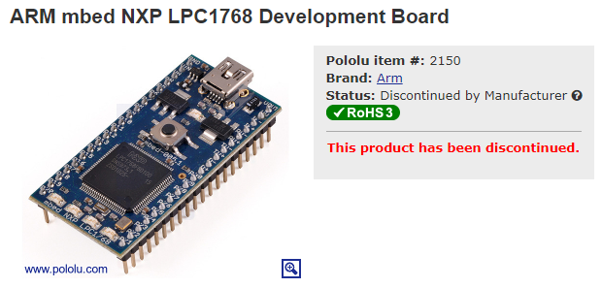
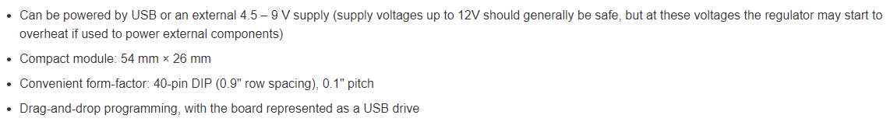

Navigation System & Controller
Microcontroller

Slide 10
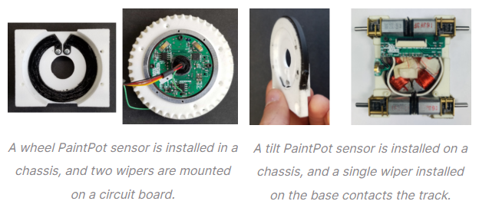
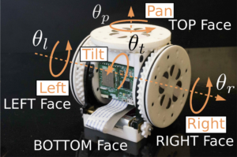
Data Collection
PaintPots (Positioning)
PaintPot process can be used to create resistive surfaces capable of sensing position in 2D on planes and spheres
A PaintPot is powered between ground and 3.3V. For wheel PaintPots, two wipers can contact the track and report measured voltage in the form of two 10bit analog-to-digital conversion values ranging from 0 to 1023. When a wiper contacts on or around the V-shape gap, the measurement is not usable. This is the reason for having two wipers, to enable sensing the full 360° range. For tilt PaintPots, a single wiper contacts the track all the time.

Slide 11
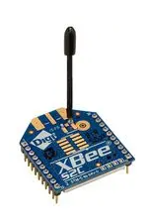

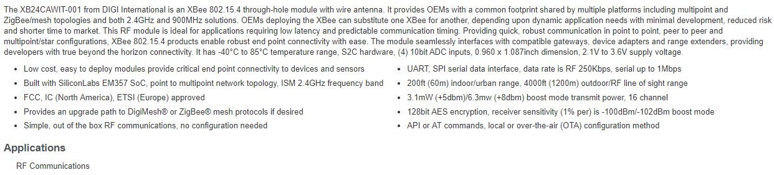
Data Transmission
https://www.instructables.com/How-to-Use-XBee-Modules-As-Transmitter-Receiver-Ar/
xBee series 1 modules

Slide 12

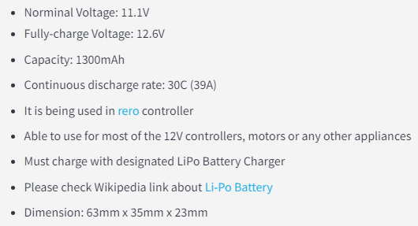
Power System Management
11.1V Battery

Slide 13

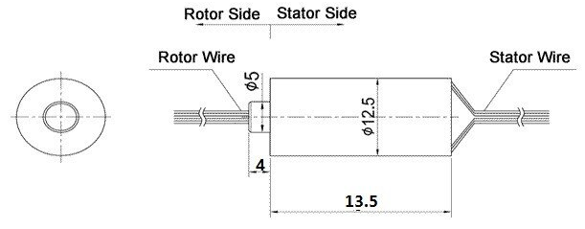
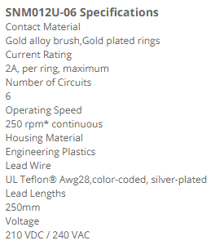
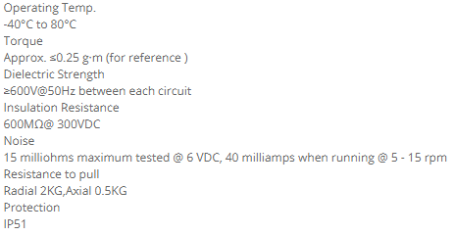
Slip Ring

